Slide 1
Block Modeling-Guided Graph Convolutional Neural Networks
AAAI 2022
Code: github.com/hedongxiao-tju/BM-GCN
2022.01.23 • ChongQing
Reported by Chenghong Li

Slide 2
Introduction

Slide 3
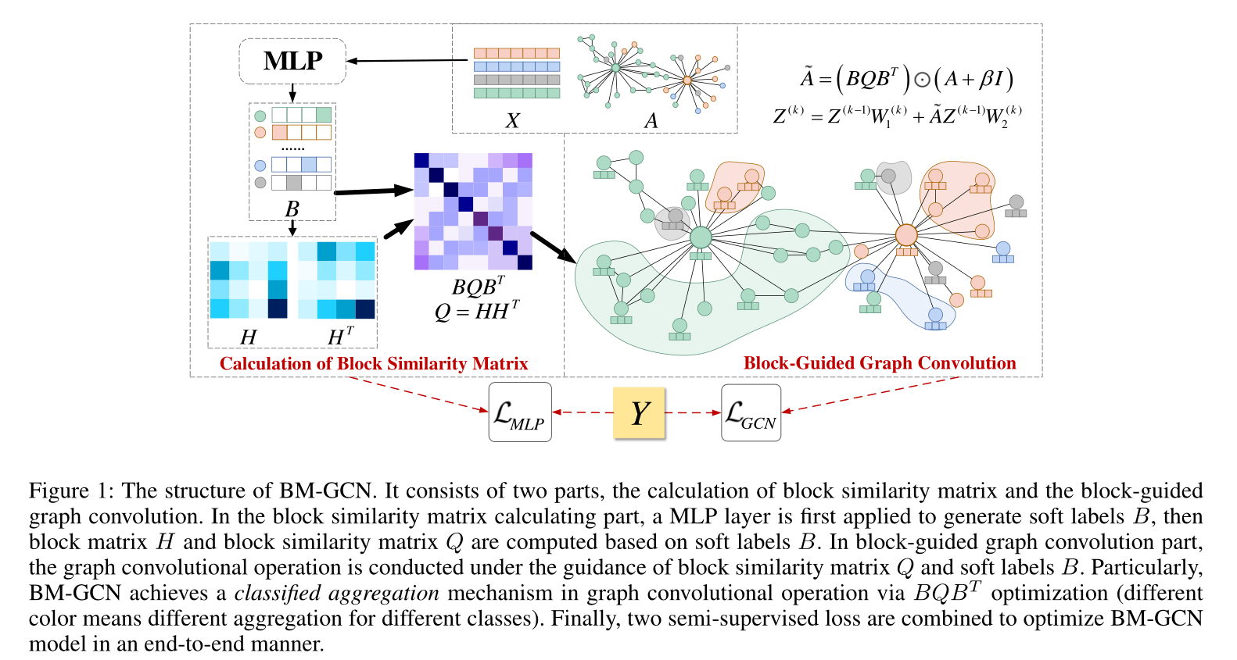
Method

Slide 4
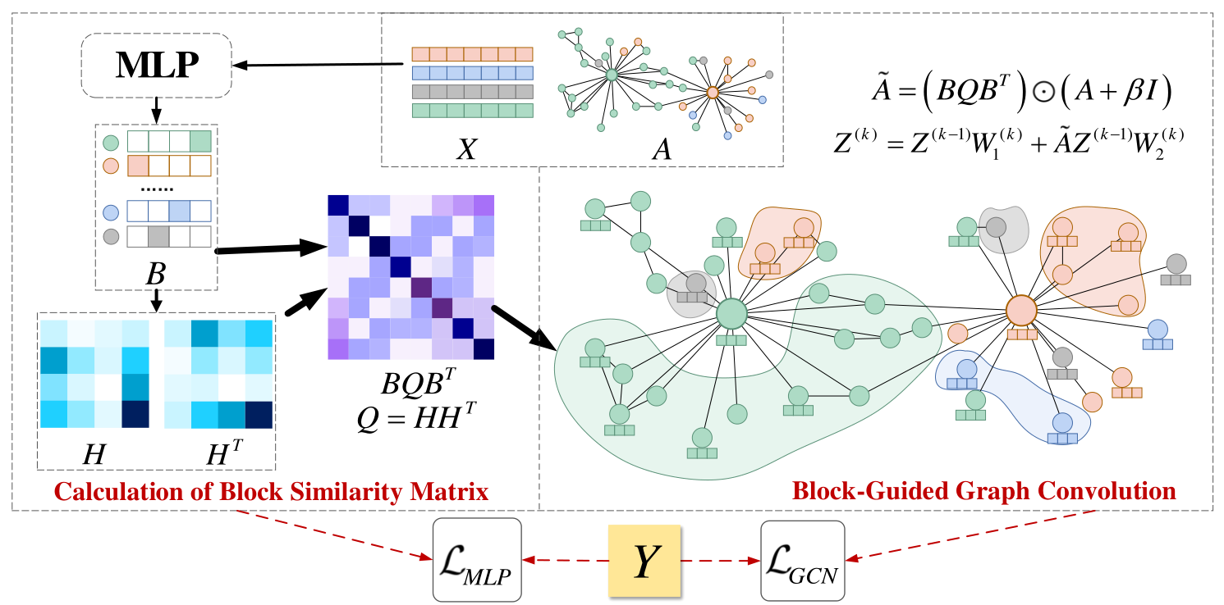
Method

Slide 5
Method

Slide 6
Method

Slide 7
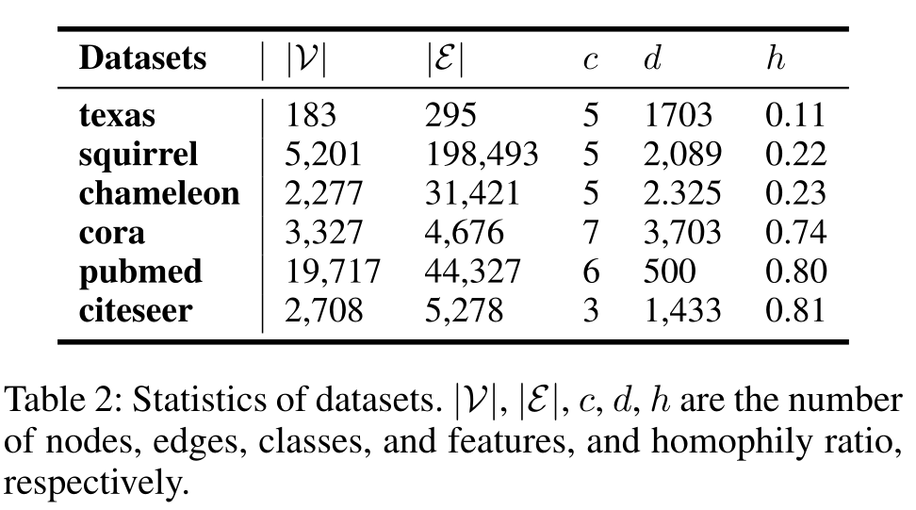
Experiments

Slide 8
Experiments

Slide 9
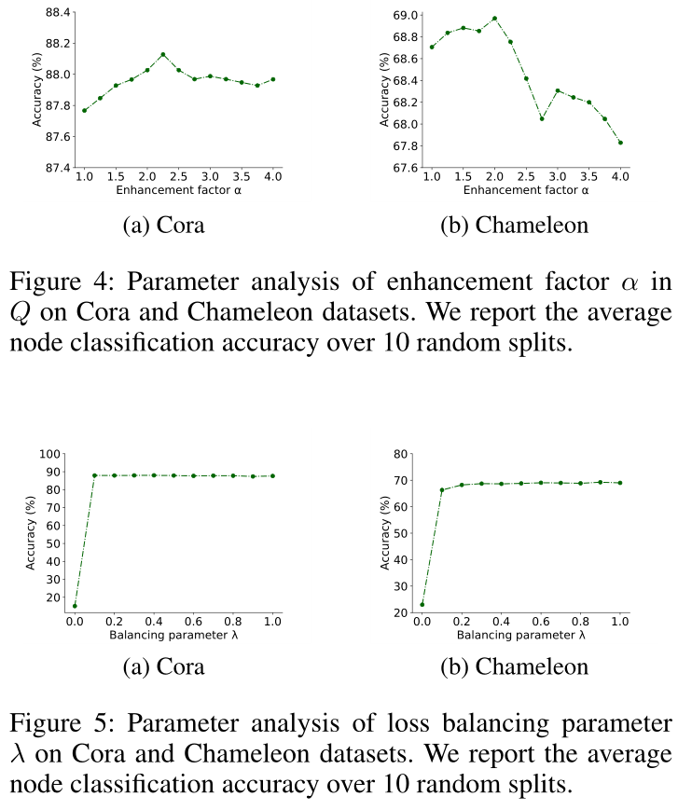
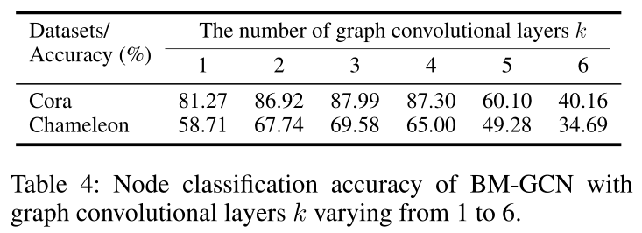
Experiments

Slide 10
Thanks

